Slide 1


SUMMER INTERSHIP-1
Jeet Haria(21IT043)
Parth Kalma(21IT057)
Ashish Khatwani(21IT066)

Slide 2
WORDPRESS
Internship Supervisor : Dishang shah
Internship Duration : 08/05/2023 – 15/06/2023
Internship Company : DSU INFOTECH

Slide 3
ABOUT DSU INFOTECH
DSU Infotech Lead by Dishang Shah established in 2012.
Dsu Infotech create a simple, corporate,affordable, effective, and manageable website with our dedicated team of experts in the web development sectors.
We create Easy to Use Affordable Webview & Hybrid Application for Android & iOS on Kotlin, Java, Flutter, React Native & Ionic Technology.
Use our Whatsapp API to Notify and send alert to your customer on whatsapp also develop your own whatsapp chatbot for Business automation.
Every time a marketing representative of the company talks to a customer, follows up a lead or meets a sales prospect data is generated.

Slide 4
INTRODUCTION TO WORDPRESS
WordPress is the most popular CMS in the world, powering 39% of all websites on the internet.
WordPress is an open-source software that allows anyone to create and manage websites and blogs without any programming or design knowledge.
WordPress was created by Matt Mullenweg and Mike Little in 2003, based on a previous CMS called b2/cafelog.

Slide 5
FEATURES OF WORDPRESS
WordPress is theme-based, which means you can choose from thousands of free and premium design themes that suit your needs and preferences.
WordPress is plugin-based, which means you can extend the functionality of your website with various modules that add features such as contact forms, e-commerce, security, SEO, etc.
WordPress is multilingual, which means you can translate your website content into different languages and reach a global audience 2.
WordPress has a built-in media management system, which allows you to upload and manage images, videos, audio files, documents, etc., and use them with your text content².

Slide 6
WORDPRESS THEMES
A WordPress theme is a collection of files that define the appearance and layout of your website.
A theme can include design elements such as colors, fonts, images, menus, widgets, etc.
WordPress provides thousands of free and premium themes that you can choose from and install on your website.
You can also create your own custom theme or modify an existing one using code or a theme builder plugin.

Slide 7
PROJECT DETAILS
Welcome to DS Online Apparel store
At DS, we are more than just a clothing store – we are a destination for fashion enthusiasts and style-seekers. With a passion for fashion and a keen eye for trends, we curate a diverse collection of high-quality apparel that reflects individuality and inspires self-expression.

Slide 8
OUR VISION
Our vision is to lead the change towards circular and climate positive fashion while being a fair and equal company. To continually create clothes and accessories that aspire to a kind of perfection that transcends fashion.
To be the world’s leading online destination for fashion lovers, offering a curated selection of the best brands and styles, personalized service, and exceptional value.
To create a more inclusive and sustainable fashion industry, where everyone can express their unique style and identity, while respecting the planet and the people who make our clothes.
To empower women to feel confident and beautiful in their own skin, by providing high-quality, affordable, and ethically-made clothing that celebrates diversity and individuality.

Slide 9
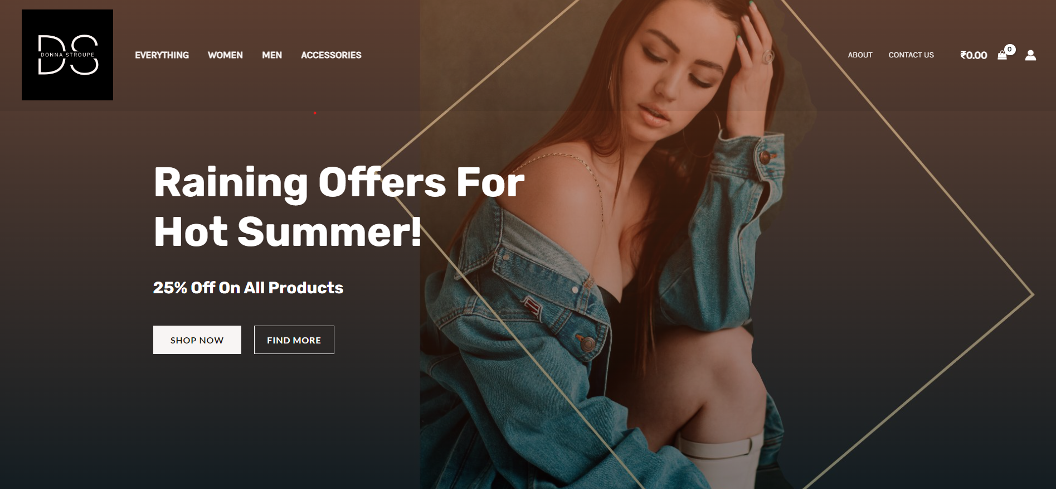
HOME PAGE

Slide 10
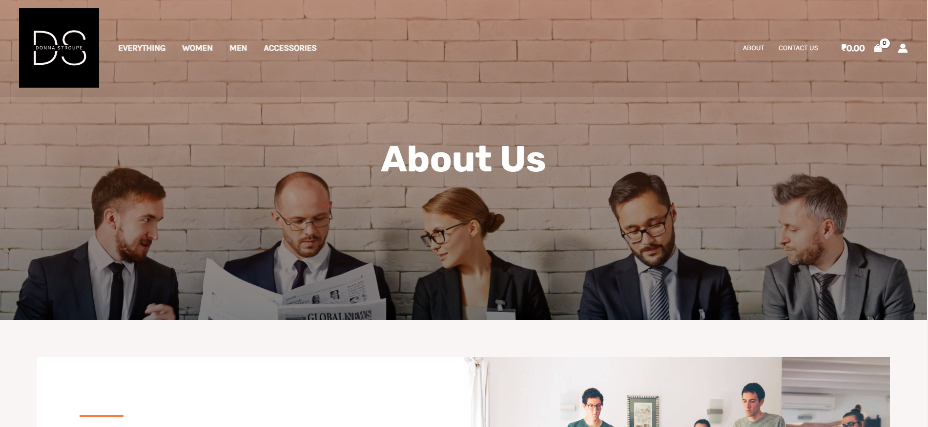
ABOUT US PAGE

Slide 11
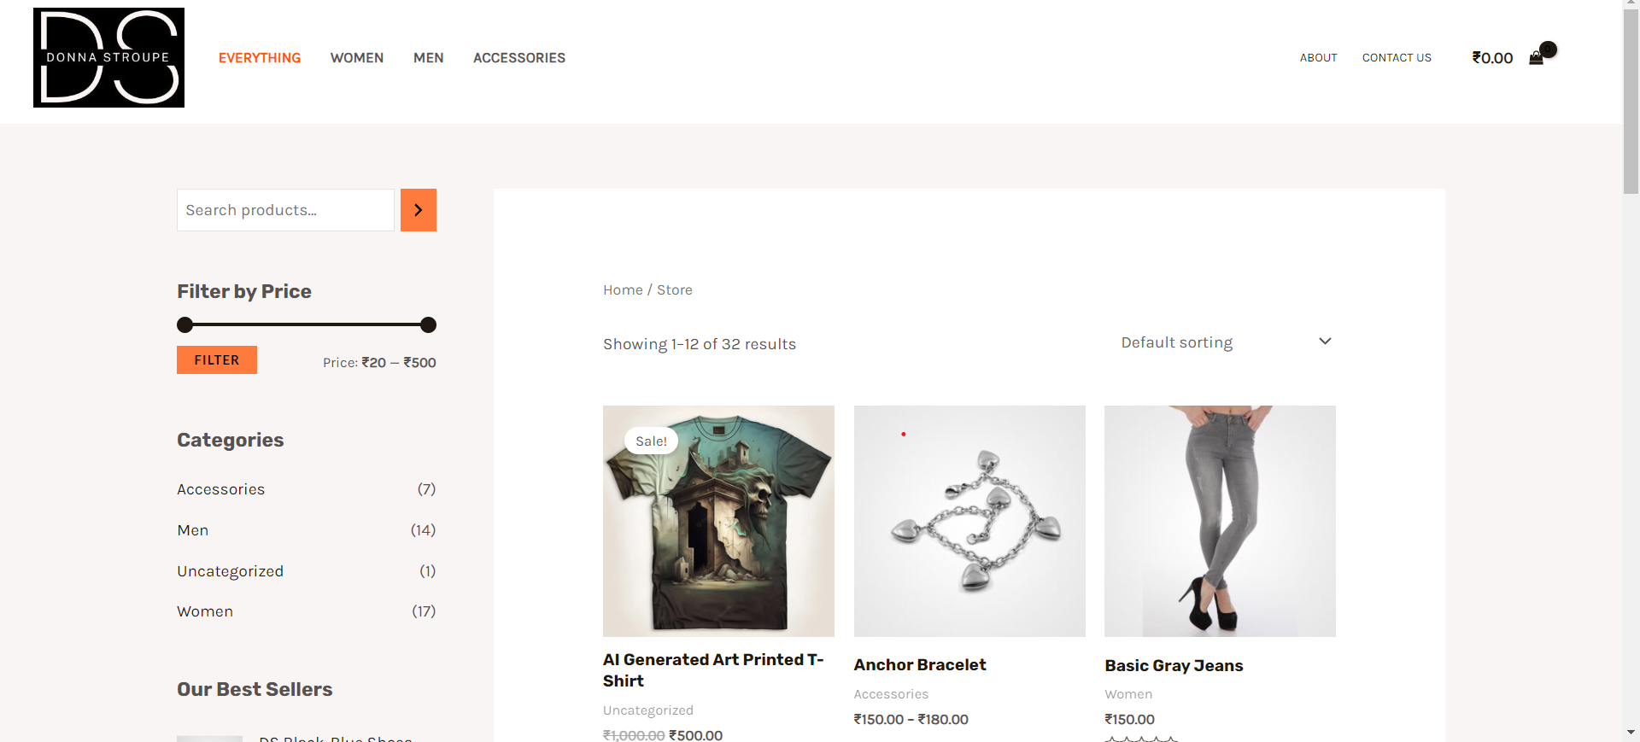
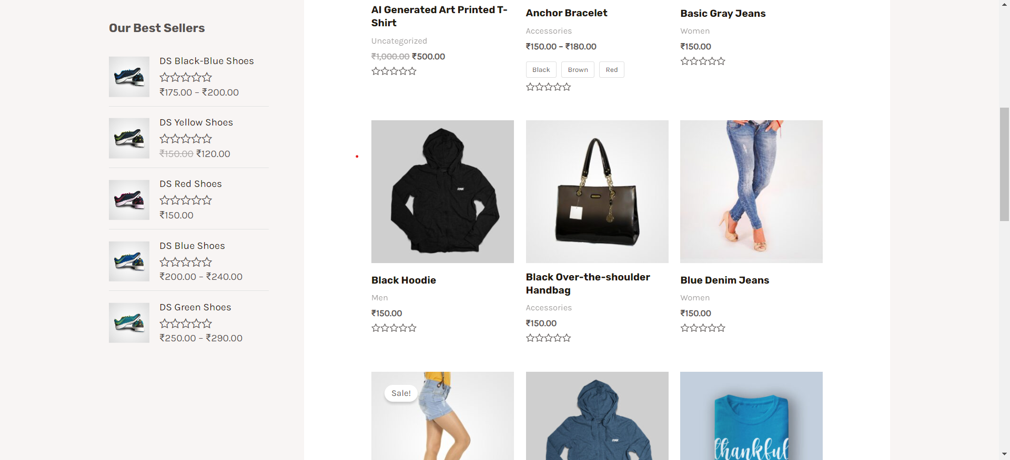
EVERYTHING PAGE

Slide 12
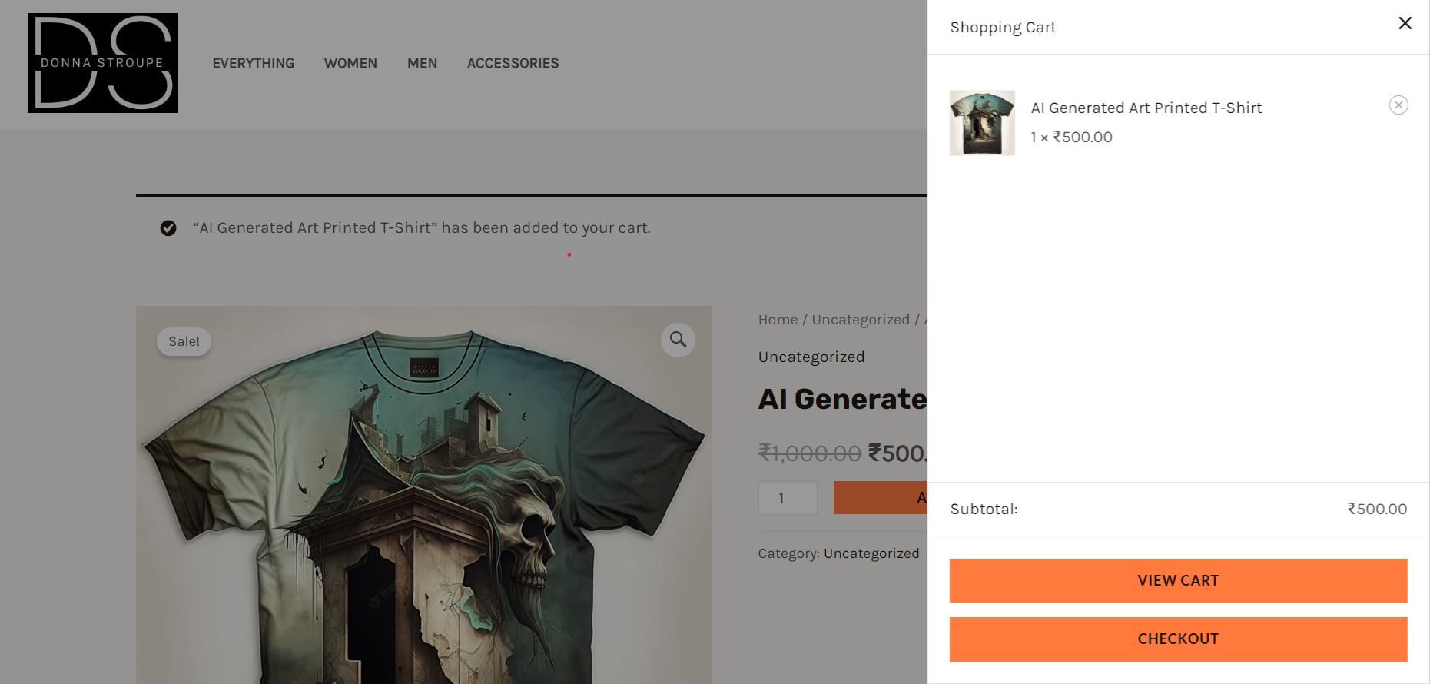
SIDE PANEL CART

Slide 13
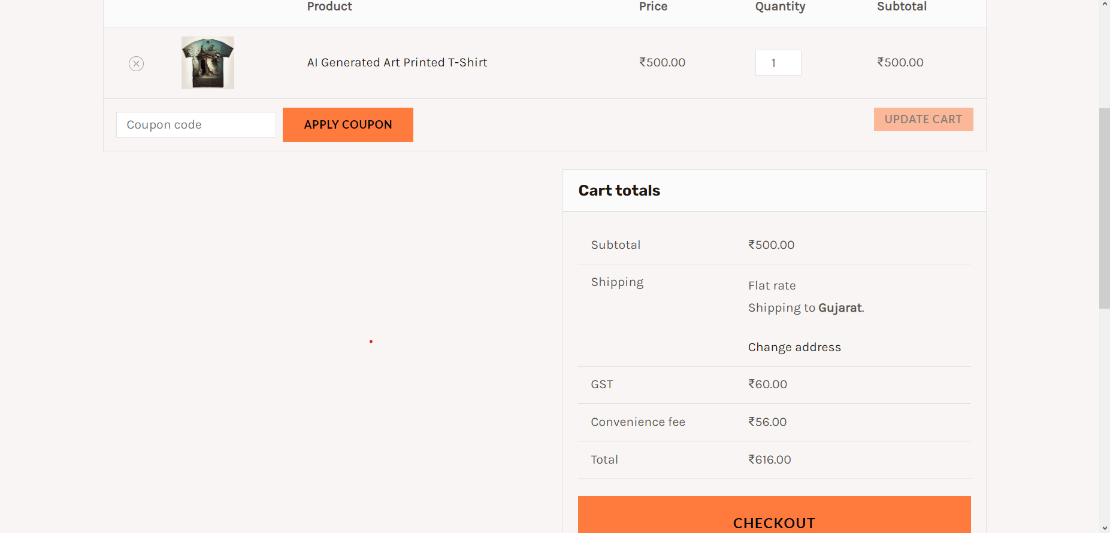
CHECHKOUT PAGE

Slide 14
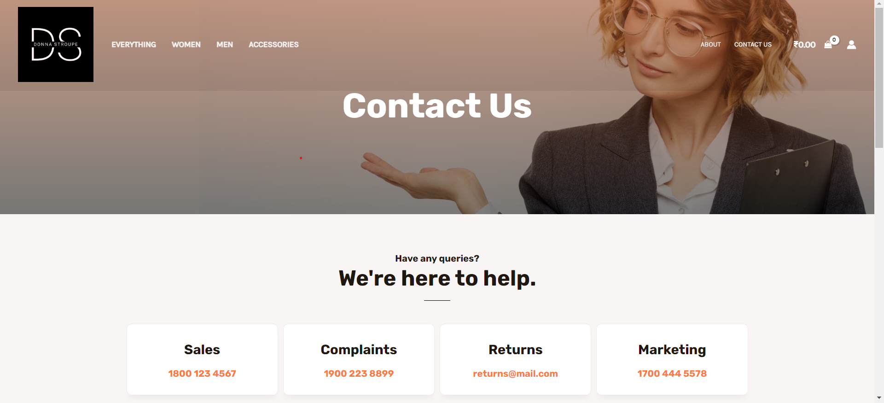
CONTACT US PAGE

Slide 15
CONCLUSION
"My internship in WordPress web development was a valuable and rewarding experience that helped me gain practical skills and insights into the ecommerce industry. During my internship, I was able to create a fully functional online store for an apparel business using WordPress, WooCommerce, and various plugins and extensions. I learned how to choose a domain name, install WordPress and WooCommerce, select and customize a theme, add products and variations, test and launch the website, and promote it online. I also learned how to use tools such as Elementor,Astra Theme,etc tools"

Slide 16
THANK YOU
Jeet Haria(21IT043)
Parth Kalma(21IT057)
Ashish Khatwani(21IT066)

